Slide 1
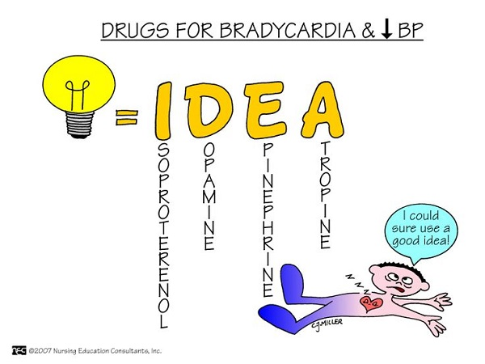
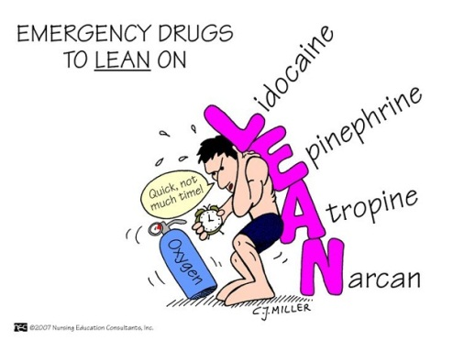
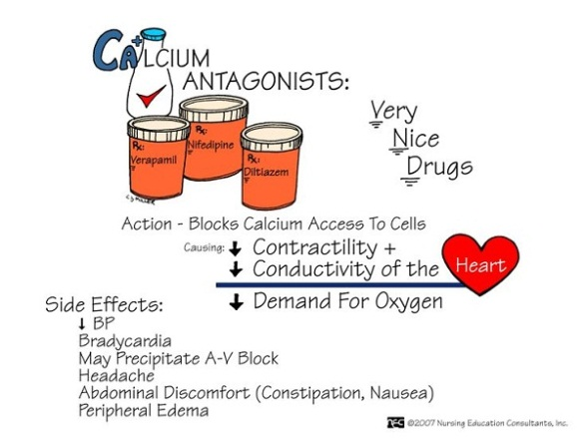
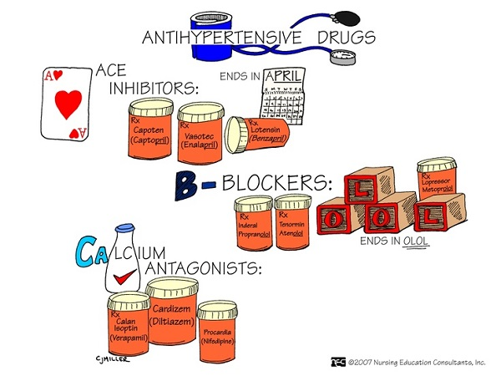
Resuscitation Drugs
City Wide ED Orientation – Jan., 2015
Adult Doses

Slide 2
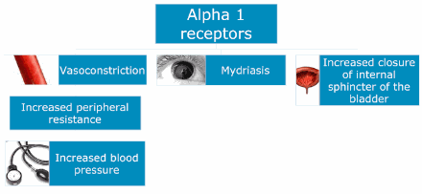
Adrenergic Receptor Sites – Alpha 1
Activation of vascular smooth muscle receptors causes vasoconstriction.
http://pharmacologycorner.com/alpha-receptors-1-2/

Slide 3
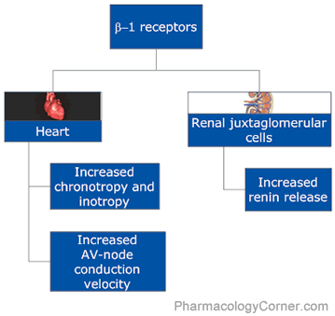
Adrenergic Receptor Sites – Beta 1
http://media.pharmacologycorner.com/wp-content/uploads/2010/07/beta2.gif

Slide 4
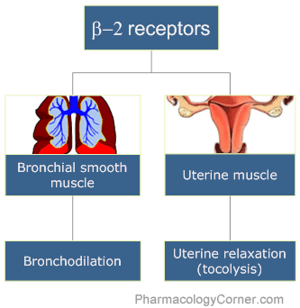
Adrenergic Receptor Sites – Beta 2
http://media.pharmacologycorner.com/wp-content/uploads/2010/07/beta2.gif
Notes:
Some beta 2 on blood vessels – stimulation causes vasodilation

Slide 5
Adrenergic Receptor Sites - Dopamine
Located in smooth muscle of renal, splanchnic, coronary, and cerebrovascular beds
When activated, release of norepinephrine is inhibited and vasodilation of vascular beds occur.
http://www.medscape.com/viewarticle/497497_2
Notes:
Splanchnic=visceral

Slide 6
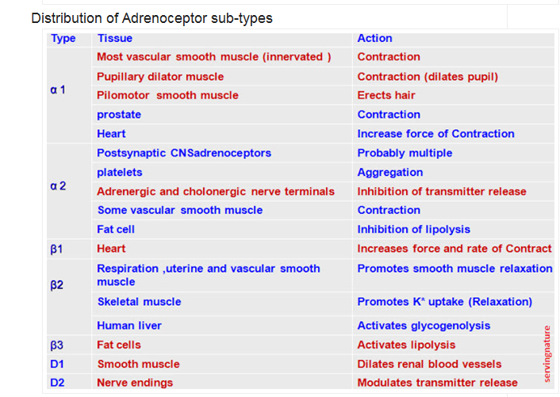
http://servingnature.blogspot.ca/2013/03/ans-receptors.html

Slide 7
Definitions
Agonist: A substance that acts like another substance and therefore stimulates an action.. An example of a beta agonist is a bronchodilator because it activates the beta-2 receptor on the muscles surrounding the airways.
Antagonist: A substance that acts against and blocks an action.. Beta blockers (i.e. Labetalol) are beta antagonists.
Chronotropic agents affect the heart rate. Positive chronotropes increase the heart rate and negative agents slow it down. Negative chronotropic drugs are just opposites of positive chronotropic agents as they slow down the heart rate by decreasing impulse formation in the SA node

Slide 8
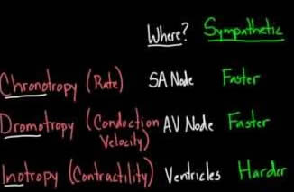
Definitions
Dromotropic agents affect conduction of electrical impulses through the myocardium. Positive dromotropic drugs increase this rate of conduction, whereas negative dromotropic drugs decrease this rate of electrical conduction.
Inotropic agents affect the contraction of the heart muscle. Positive inotropes stimulate and increase the strength of heart muscle contraction causing the heart rate to increase. Negative inotropic agents weaken the force of muscular contractions.

Slide 9
Definitions
Sympathomimetic agents: Drugs that produce an effect similar to that obtained by stimulation of the sympathetic nervous system.
Vasopressors: Drugs that induce vasoconstriction and thereby elevate mean arterial pressure (MAP). {MAP = 1/3 (SBP – DBP) + DBP}
All medication infusions with vasopressor effect should
be given via central line

Slide 10
Epinephrine
Acts on Alpha: vasoconstriction
Acts on Beta 1: positive chronotrope, inotrope &
dromotrope
Acts on Beta 2: Bronchial smooth muscle relaxation

Slide 11
Epinephrine
Increases cardiac and cerebral perfusion pressure
1 mg of 1:10,000 IV q3-5 min for arrests
Positive inotropic, chronotropic, dromotropic effects
Bronchial smooth muscle relaxation
Infusion can be used for bradycardia as 2nd line drug
Blocks further histamine release
(1:1000 solution given IM) – give for anaphylaxis
Works on both alpha and beta receptors

Slide 12
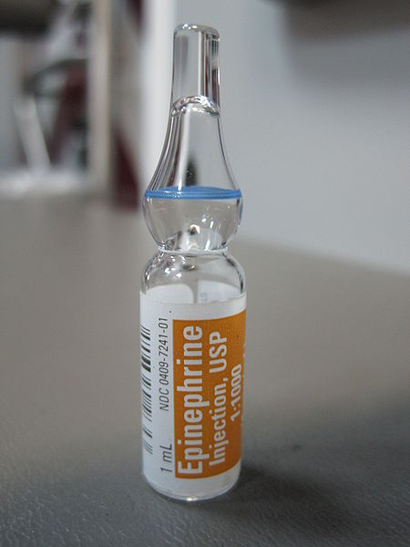
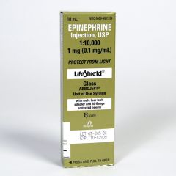
Epinephrine
1:1,000
Used in anaphylaxis
Given IM
IV Infusion for shock or bradycardia algorithm: 8 mg in 250mL
Confirm with
Colleague Guardian
Pre-mixed; 1:10,000

Slide 13
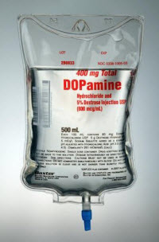
Dopamine
Vasopressor
Positive inotropic agent
Increases cardiac output (inc. in contractility,
& stroke volume)
Used in symptomatic bradycardias,
cardiogenic shock, other shocks with
cardiac compromise

Slide 14
Dopamine Dosages
Low Dosages (0.5-2 mcg/kg/min): Works on Dopamine
sites causing renal vasodilation, inc. urine output;
vasodilation in brain, mesentery, heart
Medium Dosages (2-10 mcg/kg/min): Works on Beta 1
sites resulting in improved myocardial contractility,
increased heart rate (Symptomatic Bradycardias)

Slide 15
Dopamine Dosages
High Dosages (10-20 mcg/kg/min): works on Alpha
receptors, causing vasoconstriction and elevating BP
Use central line if at all possible

Slide 16
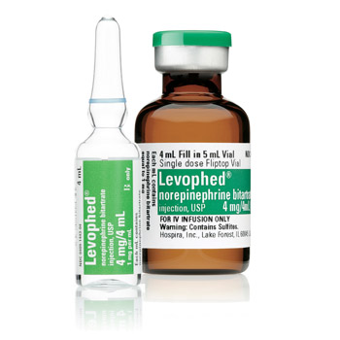
Levophed (Norepinephrine)
Works on Alpha 1 sites: vasoconstriction
Works (less) on Beta 1 sites: inc. cardiac contractility
(positive inotrope)
Commonly ordered for septic shock: 8 mg in 250 mL

Slide 17
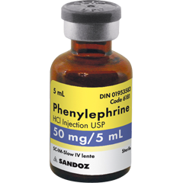
Phenylephrine
Works on Alpha sites
Given in 100mcg/mL concentrations
Can be IV direct or infusion
Used for hypotension
IV Direct: 100-500 mcg per dose every 10 to 15
minutes as needed. Initial dose should not
exceed 500 mcg
Pre-mixed syringes in fridge in resus.
LHSC, PDAM

Slide 18
Vasopressin
Potent antidiuretic hormone
Acts on blood vessels and kidneys
Peripheral vasoconstriction
Better cerebral perfusion than with epinephrine
No Beta 1 receptors

Slide 19

Vasopressin
Vasodilatory shock: continuous infusion usually between 1.2 - 2.4 units/hour. Rates as high as 6 units/hour may be required in some patients
Refractory ventricular fibrillation/pulseless ventricular tachycardia during resuscitation: 40 units IV direct. A second dose may be given 3 minutes later.

Slide 20
Vasopressin Infusion
Vial = 20 units/ml (5mls)
Infusion = 100 units (the entire vial) mixed with 100ml NS (1:1)
Usual rate: 2 units/hour (2ml/hr) Does not get titrated.
**Make sure the IV you Y it into is running FAST**

Slide 21
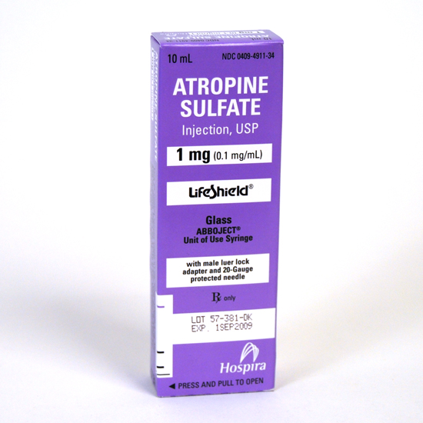
Atropine
Anticholinergic
Increases firing of the SA Node by blocking
the vagus nerve on the heart resulting in an
increased heart rate
Used in symptomatic bradycardia 1st or 2nd
degree heart block (Type I)
0.5 mg – max of 3 mg in increments
Increases oxygen demand of heart: be careful
in patients with ischemia

Slide 22
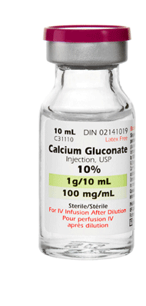
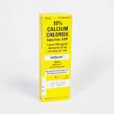
Calcium Compounds
Calcium Gluconate
Calcium Chloride
Usually inserted as infusion of 1gm over 1 hour
Can be IV direct – Minimum 200mg/min
Very hard on veins
Contains 3x as much Calcium as gluconate compound
Given IV direct over
minimum of 15
seconds.

Slide 23
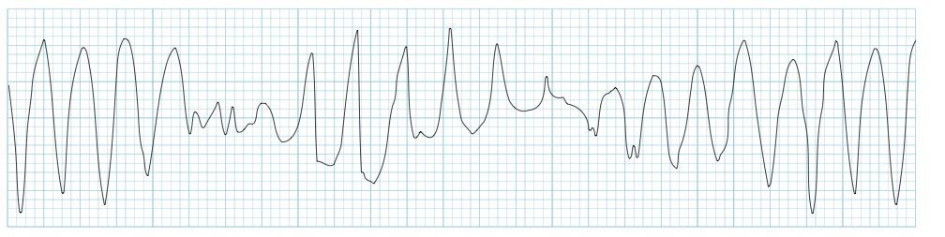
Magnesium Sulfate
Electrolyte replacement
Relaxes smooth muscle: asthma
Factors in the Na-K-Ca pump thereby affecting depolarization: works to decrease prolonged Q-T intervals which can trigger
torsades de pointes

Slide 24
MgSO4 Dosages
IV Infusion: For magnesium deficiency, 2 g may be diluted in 100 mL or more of D5W or NS and given over 1 - 3 h
IV Direct: 1.5 mL of a 10% solution or its equivalent over at least 1 minute
Too-rapid administration may cause hypotension or asystole
(PDAM)

Slide 25
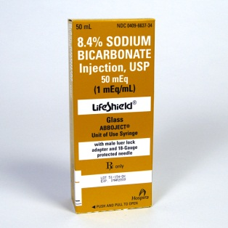
Sodium Bicarbonate
Often indicated for metabolic acidosis
Not first line of treatment in respiratory
acidosis
DKA
Lactic acidosis
Overdoses

Slide 26

Amiodarone
Antiarrhythmic
Used for both ventricular and supraventricular
rhythms
Should only be used after defibrillation/
cardioversion and first line drugs such as
epinephrine and vasopressin have failed to
convert VT/VF.
https://acls-algorithms.com/acls-drugs/amiodarone-and-acls

Slide 27
Amiodarone
Amiodarone should not be used in individuals
with polymorphic VT as it associated with a
prolonged QT interval which is made worse
with antiarrhythmic drugs.
300 mg for pulseless patients; 150mg with pulse
Dilute in D5W;
Infusions: micron filters
WATCH FOR HYPOTENSION
https://acls-algorithms.com/acls-drugs/amiodarone-and-acls

